Slide 1
SPACE CORE
REPRESENTED BY :
Aniketh Mahadik
Aditya Chougala
Girish Chachadi
Mughani Ahmed Khan

Slide 2
INTRODUCTION
SPACE CORE delivers you the idea that is basically needed for developing a skill or interest in space and stuff. Our project helps to create a world in which everyone can freely share in the sum of all knowledge. The user can be updated day to day by visiting the latest news section , where we have bonus of facts and some links that might help you. Our webpage guides the user and make him visualise things through videos and facts . The queries that make our users end up dilemma , they make themselves familiar to the contact section .The webpage is responsive so that the user can enjoy our webpage in any screen he/she likes . Our aim is to develop a descriptive webpage / blog using html , css and javascript.

Slide 3
Concept and idea of SPACE CORE
Arrangement of sections and more :
The project is to mange the details of the page, news, facts and website links. It manages all the information about space , videos , gallery and etc. The project is totally built at administrative end and thus only the administrator is guaranteed access. The purpose of the project is make the user available all the information needed and guide them.

Slide 4
What does it do ?
Manage all the contents.
Delivery of integrated info of all records of space.
Update the user with latest news based on space.
Enlighten the user with some facts and webpages.
Systematic representation of all information available

Slide 5
Idea of SPACE CORE
SPACE CORE will revolutionize the way of thinking about space. It provides a user friendly space which fits in any screen and make the user enjoy the design. The design of the page will make user to feel more comfortable to space design. SPACE CORE will make user develop ideas and positive thinking because of facts and latest news that are provided.

Slide 6
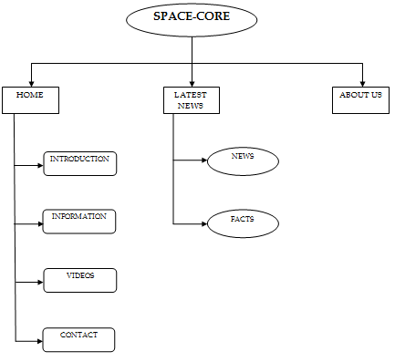
Flowchart of the webpage

Slide 7
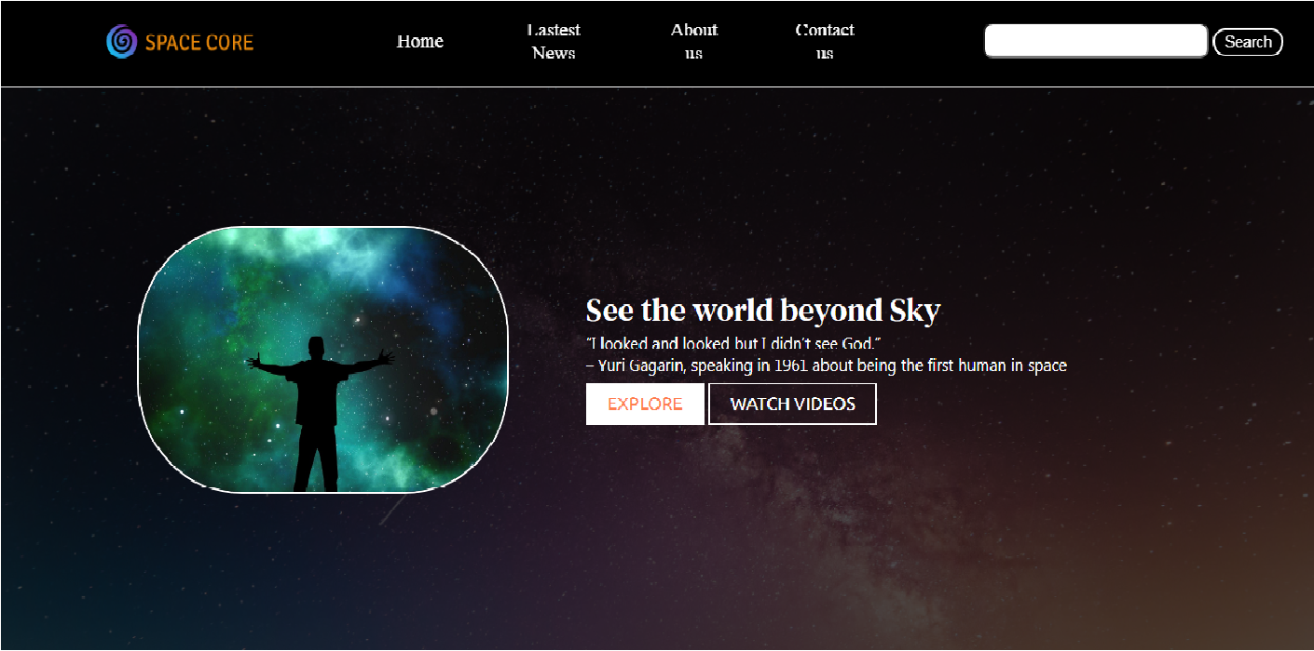
SCREENSHOTS

Slide 8
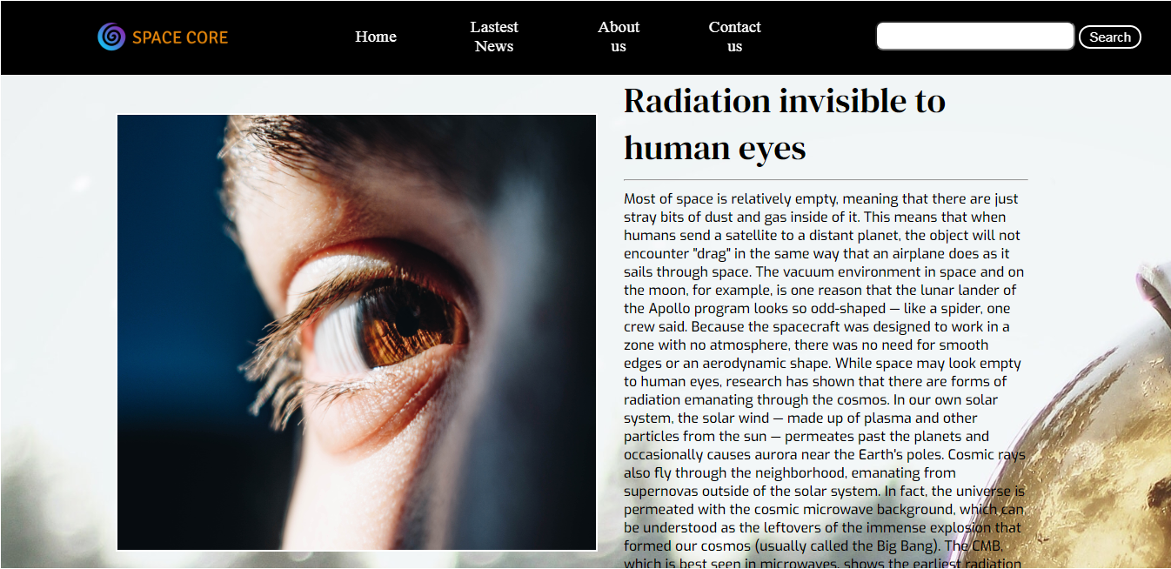
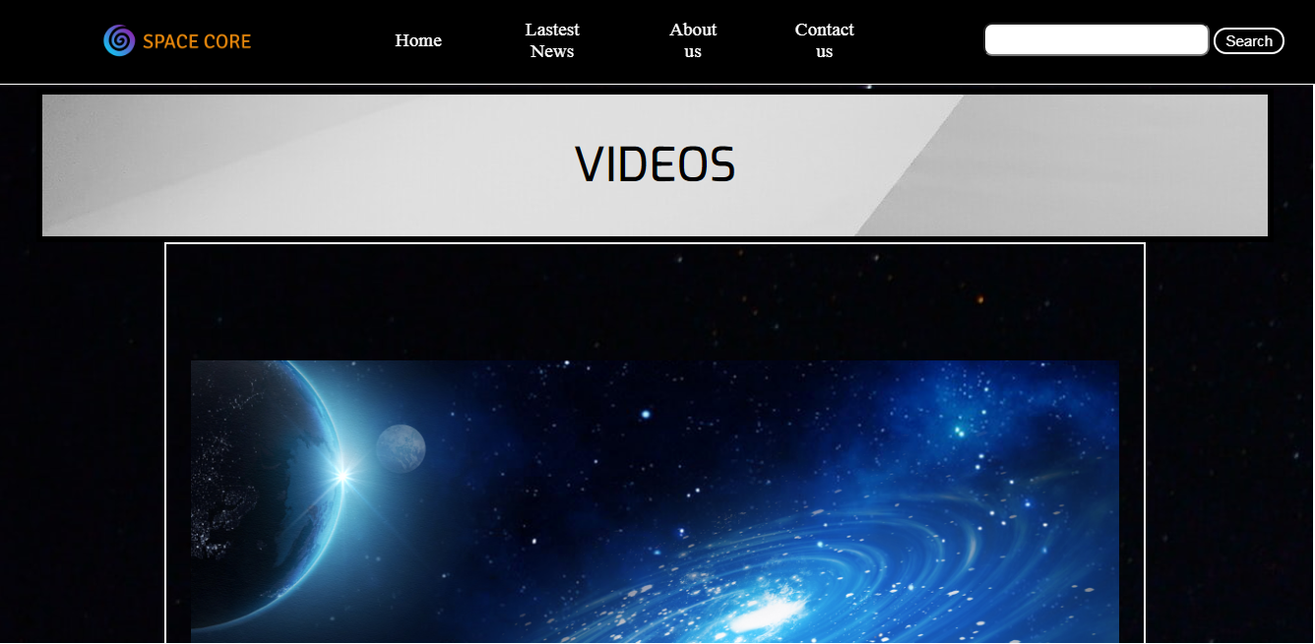

Slide 9
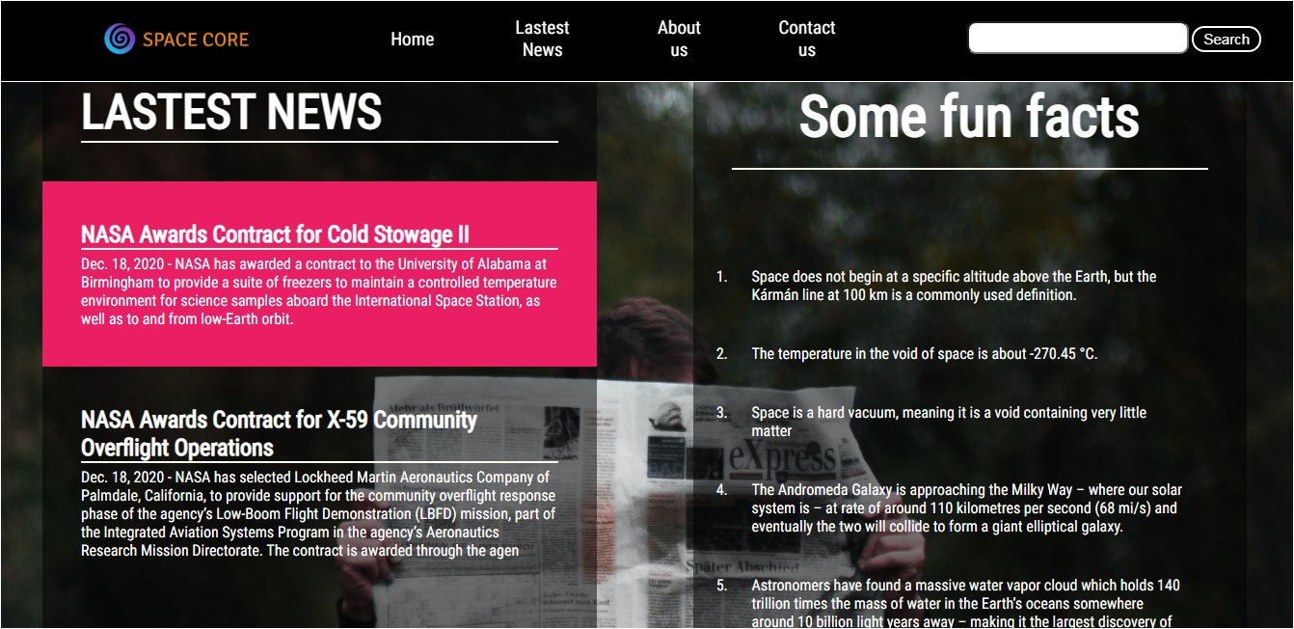
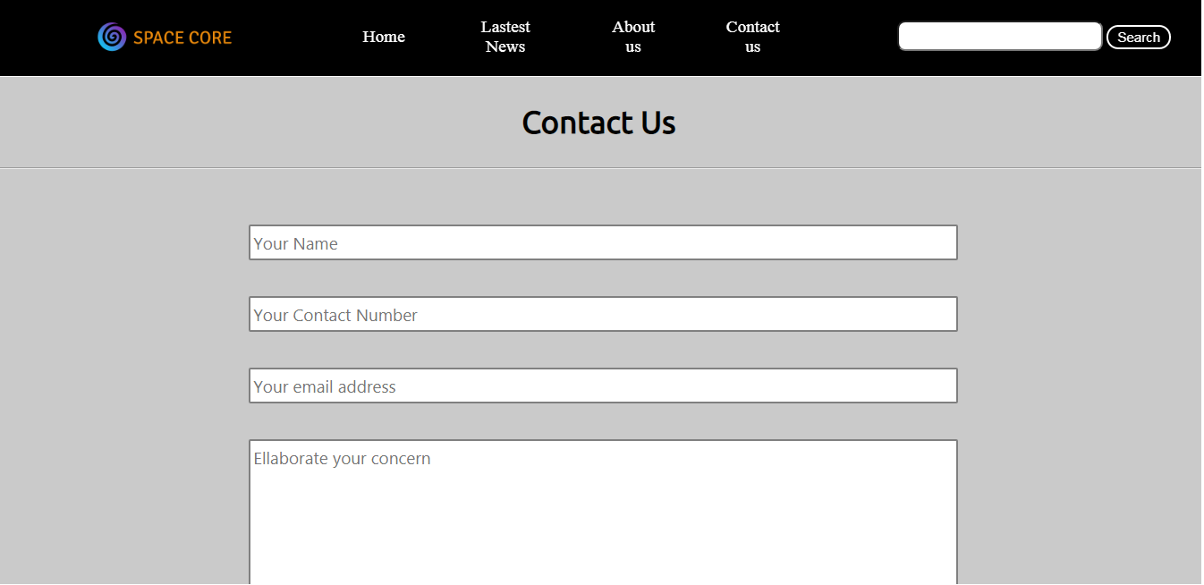

Slide 10
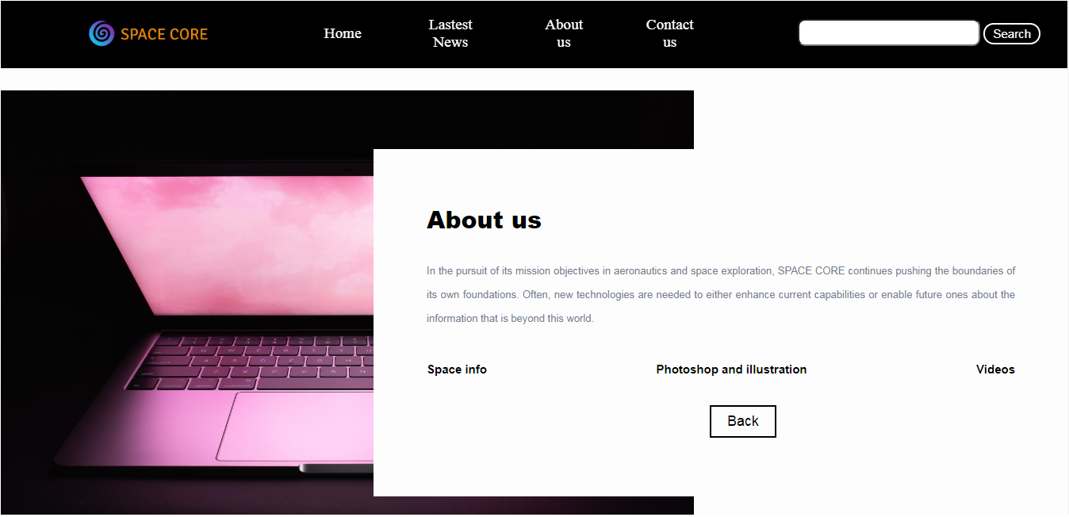

Slide 11
CONCLUSION
The purpose and objective of SPACE CORE is achieved. By providing rich and updated information , the representation is satisfies the user. We conclude that SPACE CORE ensures the satisfaction of the user about space and making it more comfortable because of the design by the use of html , css and javascript.

